Slide 1
Chapter 15
Database Administration and Security

Slide 2
Learning Objectives
In this chapter, students will learn:
  That data are a valuable business asset requiring careful management
  How a database plays a critical role in an organization
  That the introduction of a DBMS has important technological, managerial, and cultural consequences for an organization

Slide 3
Learning Objectives
In this chapter, students will learn:
  About the database administrator’s managerial and technical roles
  About data security, database security, and the information security framework
  About several database administration tools and strategies
  How various technical tasks of database administration are performed with Oracle

Slide 4
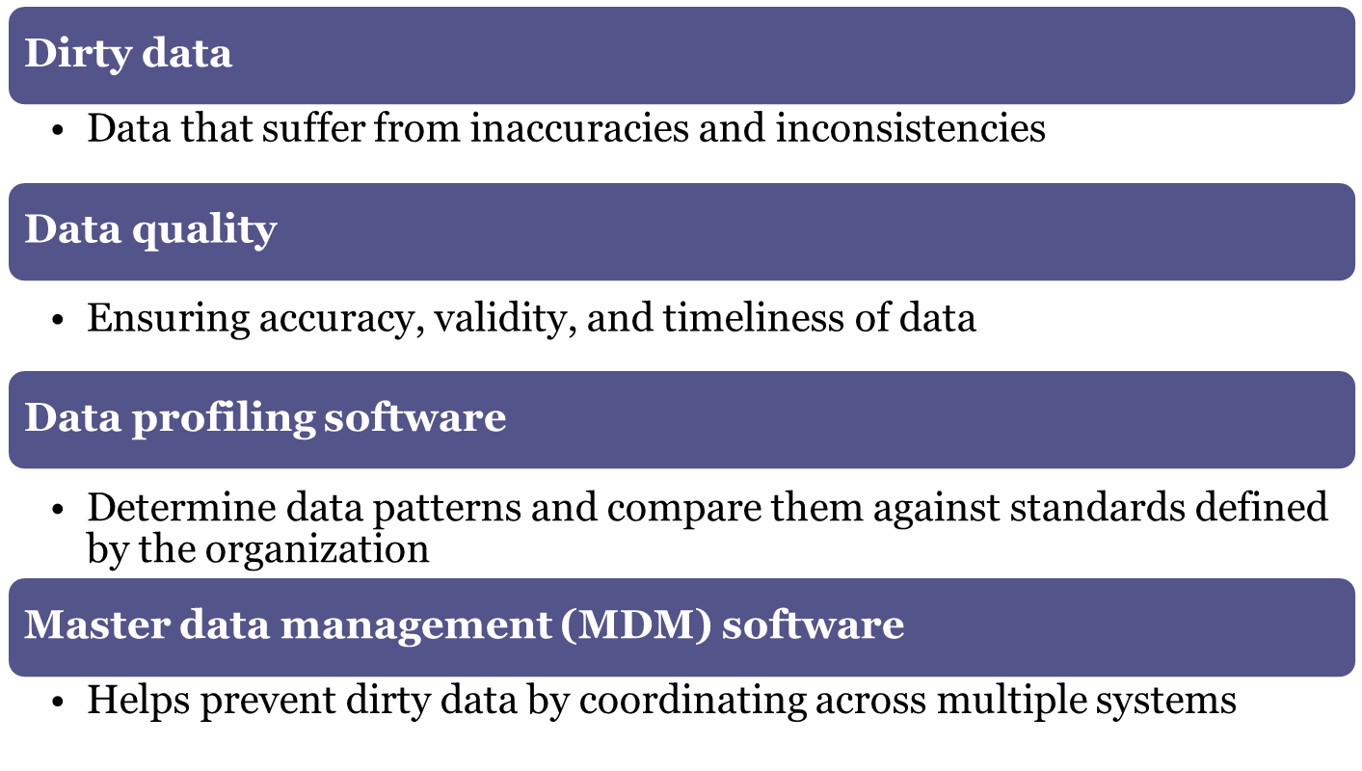
Data

Slide 5
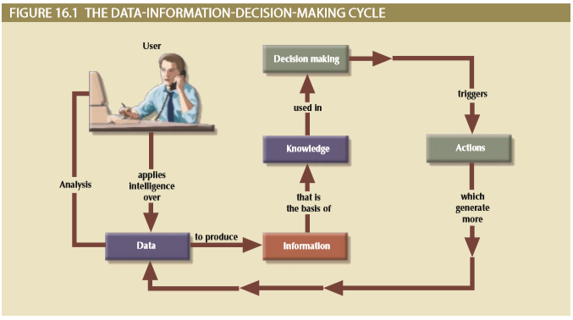
Figure 15.1 - The Data-Information-Decision Making Cycle

Slide 6
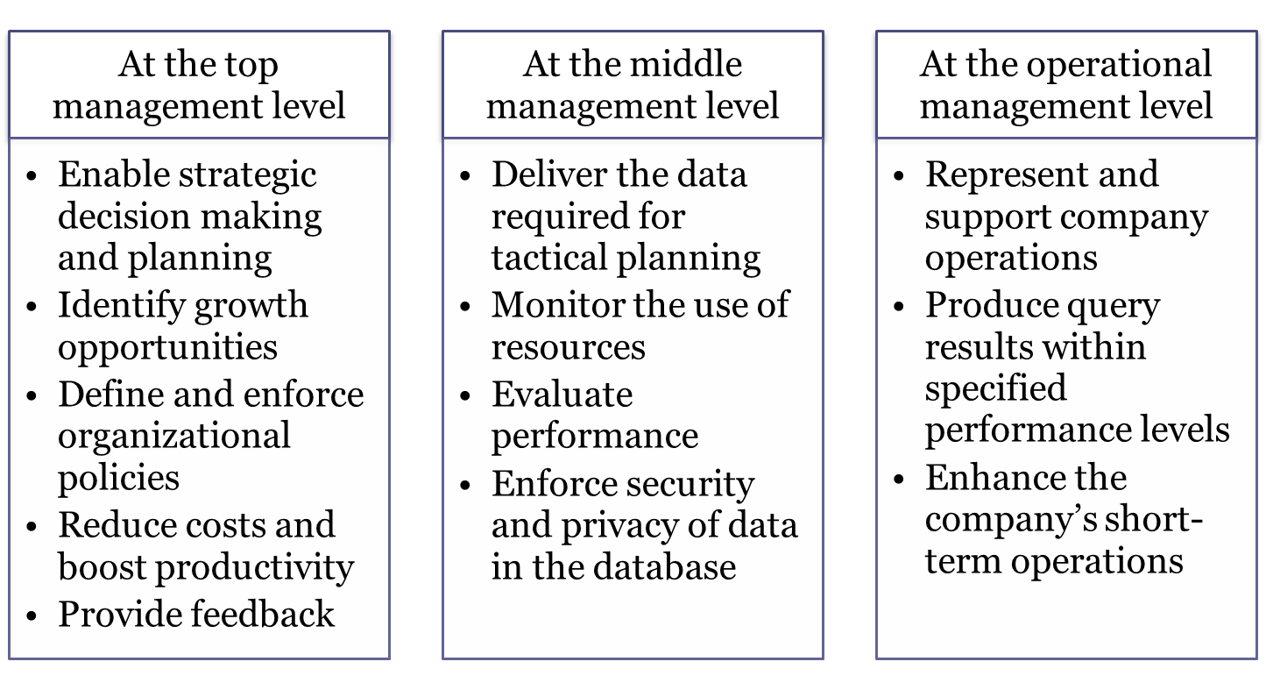
Need for and Role of Databases in an Organization

Slide 7
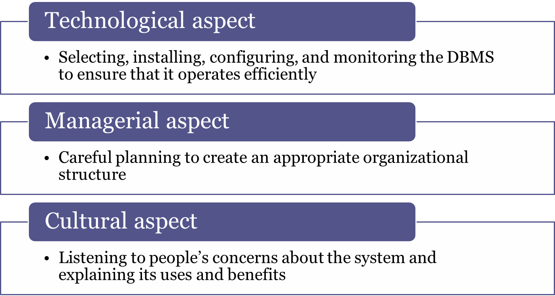
Introduction of a Database:
Special Considerations

Slide 8
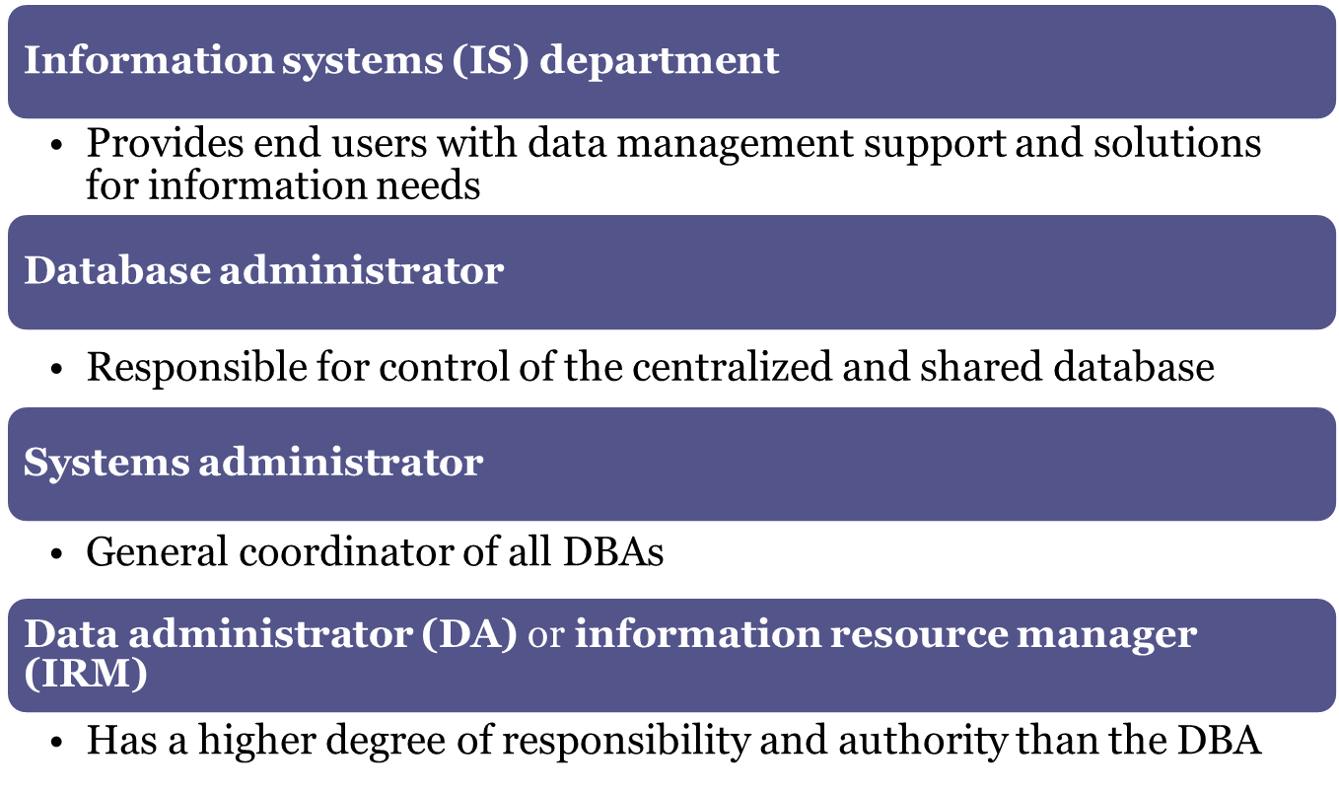
Evolution of the Database Administration Function

Slide 9
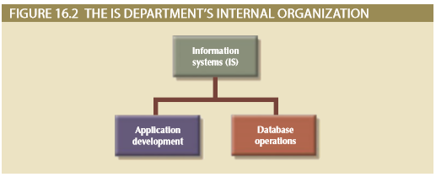
Figure 15.2 - The IS Department’s Internal Organization

Slide 10
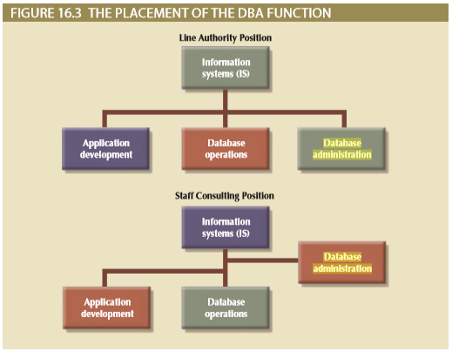
Figure 15.3 - The Placement of the DBA Function

Slide 11
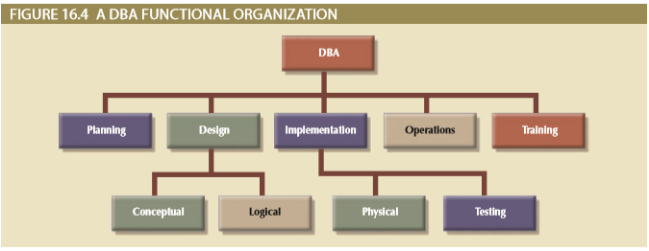
Figure 15.4 - A DBA Functional Organization

Slide 12
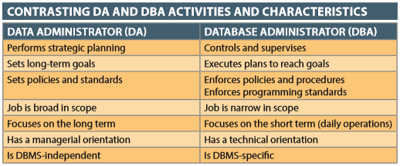
Table 15.1 - Contrasting DA and DBA Activities and Characteristics

Slide 13
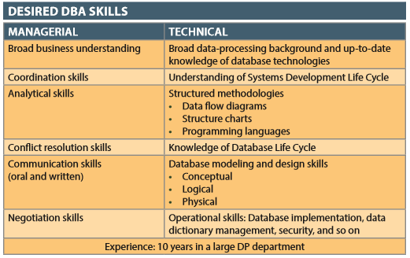
Table 15.2 - Desired DBA Skills

Slide 14
DBA’s Managerial Role
Provide end-user support
Enforce policies, procedures, and standards for correct data creation, usage, and distribution within the database
Manage data security, privacy, and integrity
Manage data backup and recovery
  Fully recover data in case of data loss
  Database security officer (DSO): Ensures database security and integrity

Slide 15
DBA’s Managerial Role
  Disaster management: Planning, organizing, and testing of database contingency plans and recovery procedures
  Full backup or database dump: Produces a complete copy of the entire database
  Incremental backup: Produces a backup of all data since the last backup date
  Concurrent backup: Takes place while the user is working on the database
Manage data distribution and use

Slide 16
DBA’s Technical Role
Evaluate, select, and install DBMS and related utilities
Design and implement databases and applications
Test and evaluate databases and applications
Operate the DBMS, utilities, and applications
Train and support users
Maintain the DBMS, utilities, and applications

Slide 17
DBA’s Role in the Cloud
Reduced role in installing and maintaining the DBMS as cloud services provide:
  DBMS installation and updates
  Server/network management
  Backup and recovery operations

Slide 18
Security Goals
Confidentiality: Protecting data against unauthorized access
Compliance: Activities that meet data privacy and security reporting guidelines
Integrity: Keeping data consistent and free of errors or anomalies
Availability: Accessibility of data whenever required by authorized users and for authorized purposes

Slide 19
Security Policy
Collection of standards, policies, and procedures created to guarantee security
  Ensures auditing and compliance
Security audit process
  Identifies security vulnerabilities
  Identifies measures to protect the system

Slide 20
Security Vulnerability
Weakness in a system component that could allow unauthorized access or cause service disruptions
Categories - Technical, managerial, cultural, and procedural
Security threat: Imminent security violation
Security breach: Occurs when a security threat is exploited and could lead to a database whose integrity is preserved or corrupted

Slide 21
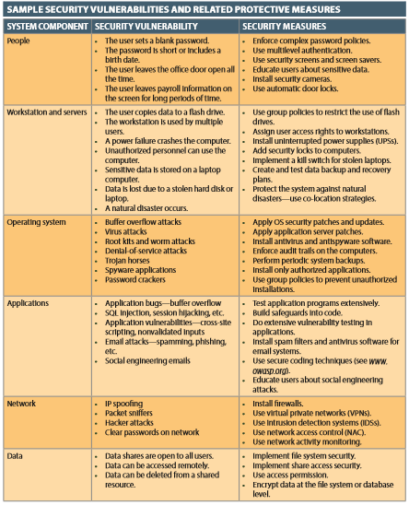
Table 15.4 - Sample Security Vulnerabilities and Related Protective Measures

Slide 22
Database Security
DBMS features and related measures that comply with the security requirements
Authorization management: Procedures to protect database security and integrity
  User access management
  View definition
  DBMS access control
  DBMS usage monitoring
    Audit log: Automatically records description of database operations performed by all users

Slide 23
Data Dictionary
Types
  Integrated - Included with the DBMS
  Standalone - Third-party systems
Active data dictionary: Automatically updated by the DBMS with every database access
Passive data dictionary: Requires running a batch process
Main function - Store description of all objects that interact with the database

Slide 24
Data Dictionary or Information Resource Dictionary
Metadata is the basis for monitoring database use and for assigning access rights to users
DBA uses data dictionary to support data analysis and design

Slide 25
Computer-Aided Systems Engineering (CASE) Tools
Automated framework for the Systems Development Life Cycle (SDLC)
Use structured methodologies and powerful graphical interfaces
Front-end CASE tools: Provide support for the planning, analysis, and design phases
Back-end CASE tools: Provide support for the coding and implementation phases

Slide 26
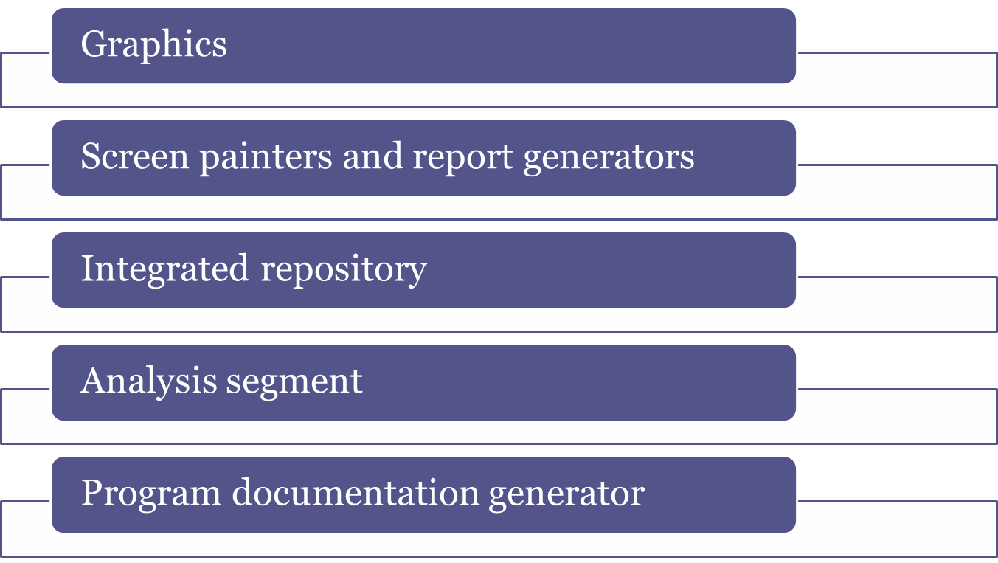
Components of a CASE Tool

Slide 27
Developing a Data Administration Strategy
Information engineering (IE): Translates strategic goals into data and applications
Information systems architecture (ISA): Helps plan, develop, and control future information systems
Critical success factors
  Management commitment and defined standards
  Thorough analysis of the company situation
  End-user involvement, training, and a small pilot project

Slide 28
Using Oracle for Database Administration
Ensure that the RDBMS starts automatically
Create tablespaces and datafiles
  Tablespace: Logical storage space
  Datafile: Physically stores the database’s data
Manage users and establish security
  User: Allows a given person to log on to the database
  Role: Authorize a user to connect to the database and use its system resources
  Profile: Control how much database resource a user can use

Slide 29
Using Oracle for Database Administration
Customize the database initialization parameters
  Initialization parameters reserve resources used by the database at run time
  After modifying parameters, database may be required to restart

Slide 30
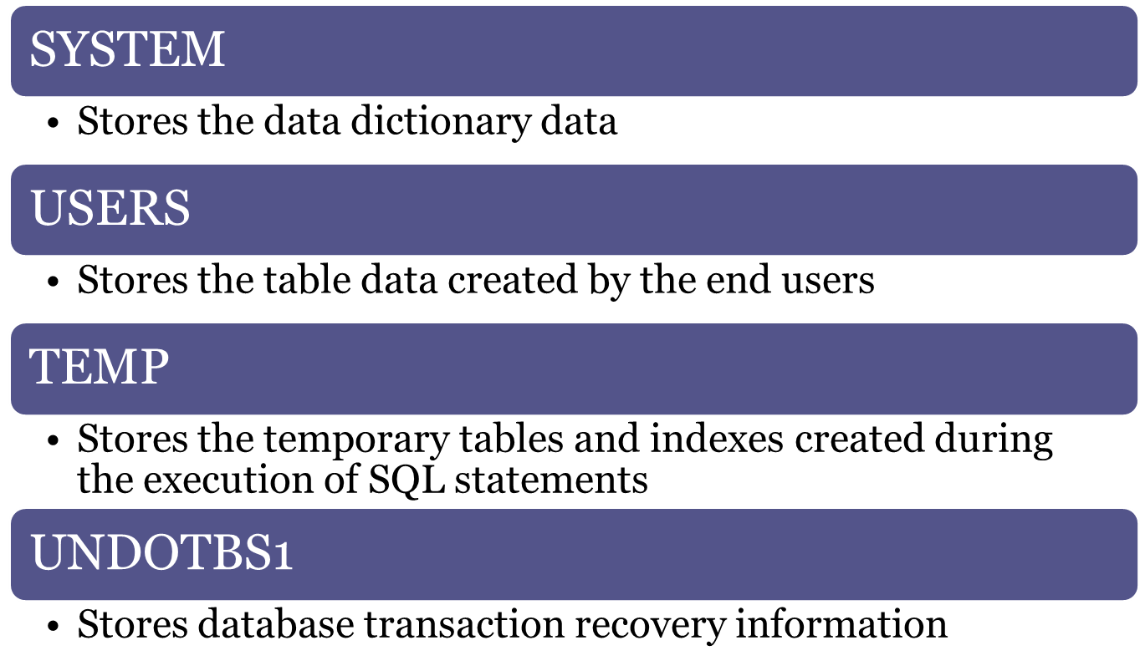
Types of Tablespace

